Slide 1
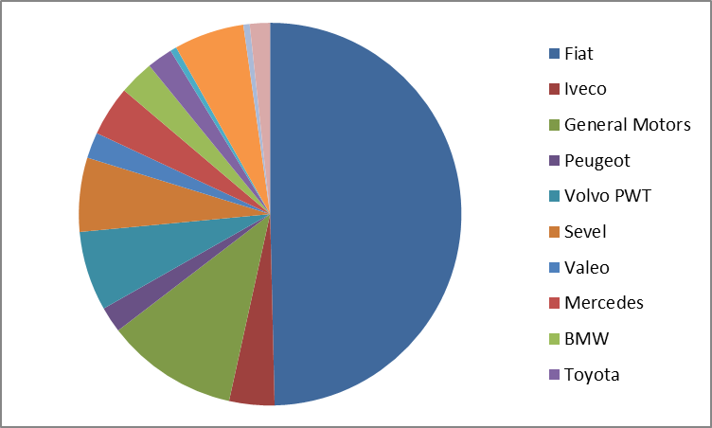
Supplier Information
Nome Azienda
COM
xxx
Owner
Private families
Location
Via xxx 1 – 10043 Orbassano (TO)
Employees
1200
DUNS-Nr.
LAMBORGHINI ➔ xxxxxxxx
Turnover
104 ML€ (20)
Contact
Mr. Position: Marketing & Sales Director
Phone: +39-(0) xxxxx Email: xxx
References
(in OEM)
Portfolio (in Automotive)
2014
Q certification
Certification (ISO TS16949, QS9000, iso14001, GM QSB)

